Slide 1
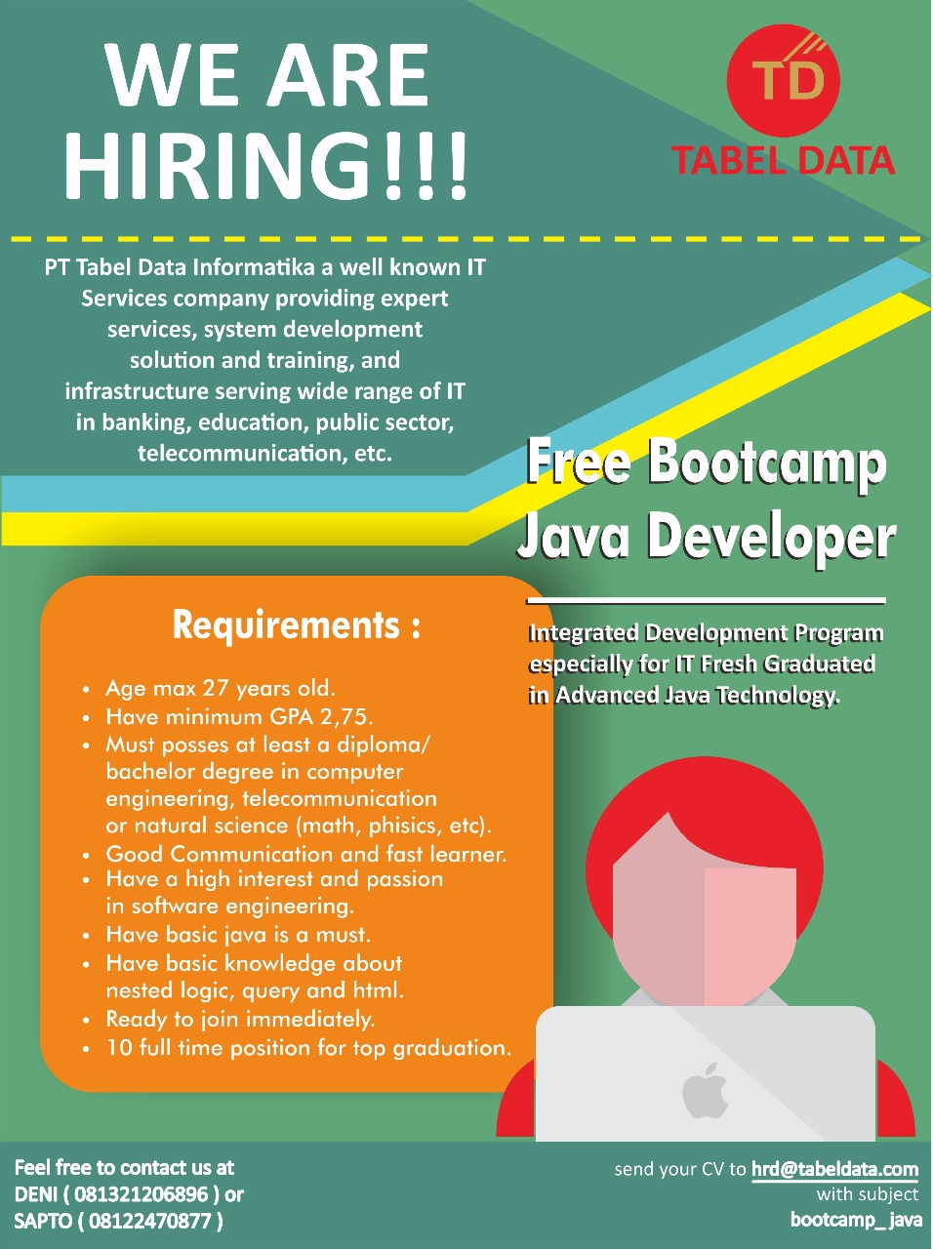
Bootcamp Java Developer #Day 3
PT. Tabel Data Infromatika
By Dimas Maryanto,S.Kom

Slide 2
Spring Data JPA
Spring Data JPA, part of the larger Spring Data family, makes it easy to easily implement JPA based repositories. This module deals with enhanced support for JPA based data access layers. It makes it easier to build Spring-powered applications that use data access technologies.

Slide 3
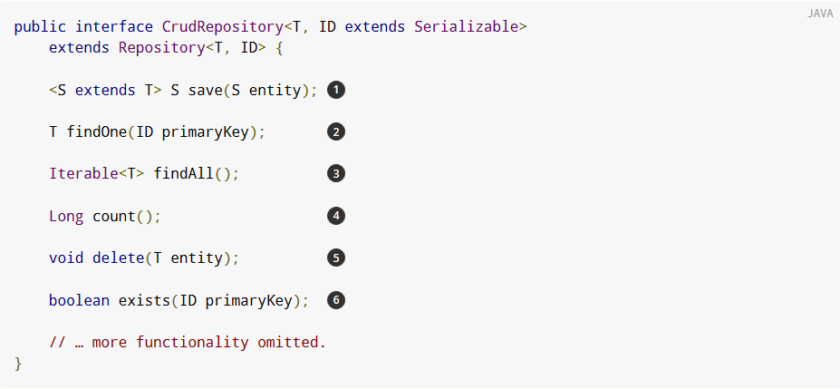
Core consepts
The central interface in Spring Data repository abstraction is Repository (probably not that much of a surprise). It takes the domain class to manage as well as the id type of the domain class as type arguments. This interface acts primarily as a marker interface to capture the types to work with and to help you to discover interfaces that extend this one. The CrudRepository provides sophisticated CRUD functionality for the entity class that is being managed.

Slide 4
Setup
Datasource
SessionFactory / Entity Manager
Transaction Manager

Slide 5
Query method

Slide 6
@Query

Slide 7
@Sort

Slide 8
Modifying queries

